Slide 1




2017 NSBE Hackathon
Team gNET
Names

Slide 2
School
City
Major
Email
Extension
Storage Database
Request
Store
Filter
Student
Recruiter
Chat
Google+

Slide 3

NET+

Slide 4
Front End

Slide 5
Push/Pull

Slide 6
Back End

Slide 7
Challenges

Slide 8
Demonstration

Slide 9
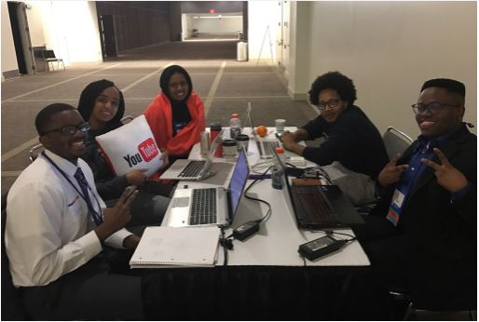

Slide 10
Thank You!

Slide 11
Questions?

